Slide 1
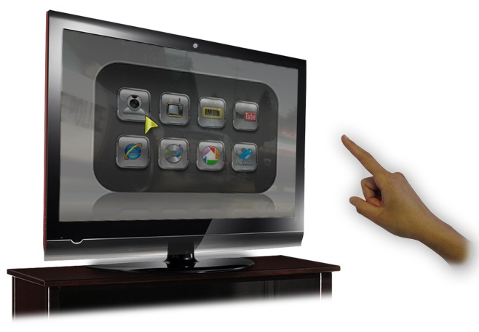
HANDLING BASIC WINDOWS OS OPERATIONS
USING GESTURE INPUT
Department of Computer Engineering,
K. K. Wagh Institute of Engineering Education & Research, Nasik (2013-2014)
Guided By:
Prof. Chaitali Patil
Presented By:
Saket Joshi (B80134303)
Shounak Gujarathi (B80134238)
Abhishek Mirge (B80134343)
Project Id: 14
PID: 14
1/24

Slide 2
CONTENTS
Sr. No. | Topic | Page No.
01. | Problem Definition | 03
02. | Need of Project | 04
03. | Domain Analysis | 05
04. | Market Survey | 06
05. | Block Diagram | 07
06. | Modules | 08
07. | Object Detection | 12
08. | Assumptions and Dependencies | 16
09. | End Users | 17
10. | Requirements | 18
11. | Functional Requirements | 19
12. | Mathematical Model | 20
13. | Project Timeline | 21
14. | Conclusion | 22
13. | References | 23
PID: 14
2/24

Slide 3
PROBLEM DEFINITION
Handling of basic windows operations such as switching between the tabs of windows, minimize, maximize and closing a window, opening the start menu, task manager, command prompt etc.
PID: 14
3/24

Slide 4
NEED OF THE PROJECT
Control the computer from a distance
Secondary input as compared to primitive keyboard and mouse to control the Windows OS
To add comfort and variety to everyday use of computers
PID: 14
4/24

Slide 5
DOMAIN ANALYSIS
Computer vision is a field that includes methods for acquiring, processing, analysing, and understanding images
It represents high dimensional data in numeric or symbolic form
Sub-domains of computer vision are:
Scene reconstruction
Video tracking
Object recognition
Learning
Indexing
Motion estimation
Image restoration
PID: 14
5/24

Slide 6
MARKET SURVEY
Leap Motion
Cost is very high
Requirement of an external hardware device
Works only with “Airspace” apps
Sony Vaio Gesture Input
Works only on Sony Vaio devices
Inaccurate in object recognition
PID: 14
6/24

Slide 7
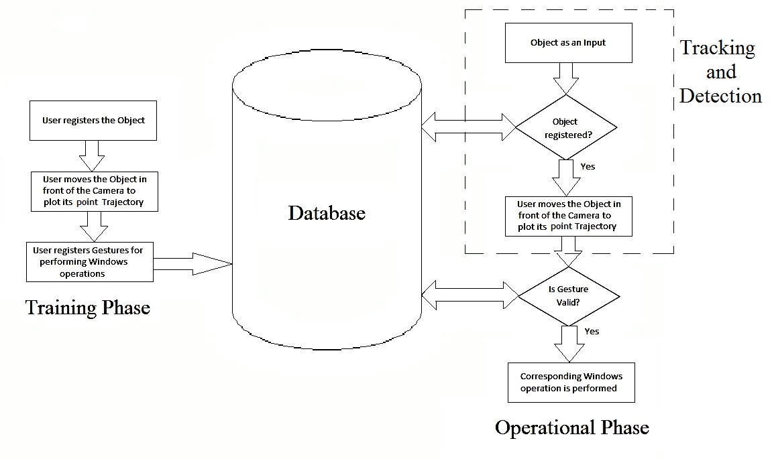
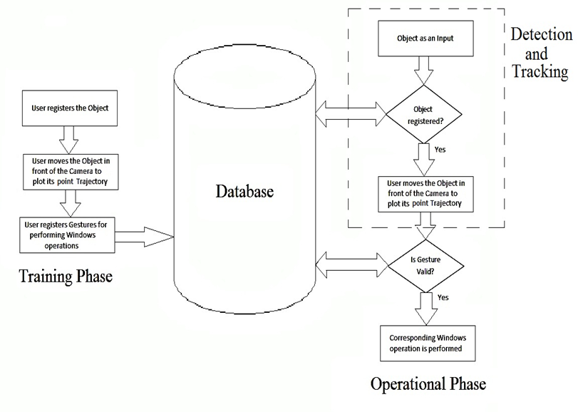
BLOCK DIAGRAM
PID: 14
7/24

Slide 8
MODULES
Phase I (Training Phase)
Phase II (Detection and Tracking )
Phase III (Performing Operation)
PID: 14
8/24

Slide 9
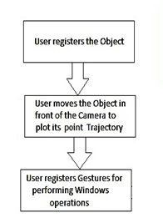
THE TRAINING PHASE
Selection of an object by the user
Recording the gestures in the database
Assigning operations to the specific gestures
PID: 14
9/24

Slide 10
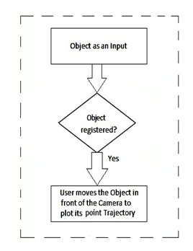
DETECTING THE GESTURES
Recognizing the object
Observing the trajectory of the object
PID: 14
10/24

Slide 11
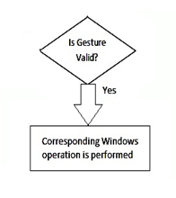
PERFORMING THE OPERATION
Matching the recorded trajectory with the training phase data
Choosing the closest match
Executing the operation associated with the gesture
PID: 14
11/24

Slide 12
OBJECT DETECTION
CAMshift Algorithm
Based on HSV of the object
Used to record the trajectory of the object
Able to track at a faster rate
Improper detection in adverse illumination
It is not robust against background noise
PID: 14
12/24

Slide 13
OBJECT DETECTION
Improved CAMshift Algorithm
Adjusts the threshold of S and V adaptively against
environmental changes
Makes hue value more robust to illumination
Avoids partial detection of object by setting a minimum
ratio of the effective pixels to all pixels in search window
PID: 14
13/24

Slide 14
OBJECT DETECTION
SURF Algorithm
Pattern matching algorithm
Grayscale based algorithm, so illumination invariant
Immune to object rotation, scaling and shifting
PID: 14
14/24

Slide 15
OBJECT DETECTION
Improved CAMshift with SURF Algorithm
Used as the tracking performance of the prevalent method
not ideal when background is very similar to the object
Object can be lost under dynamic background
Determining whether the object is lost using Bhattacharya
distance
SURF Algorithm is used to re-detect the lost object
PID: 14
15/24

Slide 16
ASSUMPTIONS AND DEPENDENCIES
Assumptions
User inputs one gesture at a time
Dependencies
The quality of the recording camera
Computational power
PID: 14
16/24

Slide 17
END USERS
Any person using Windows 7 Operating System having a camera
PID: 14
17/24

Slide 18
REQUIREMENTS
Good camera for recording
Computer with a good computational power
PID: 14
18/24

Slide 19
FUNCTIONAL REQUIREMENTS
Detect a custom object
Record the gesture
Assign a gesture to an action
Perform the operations specific to the gesture
PID: 14
19/24

Slide 20
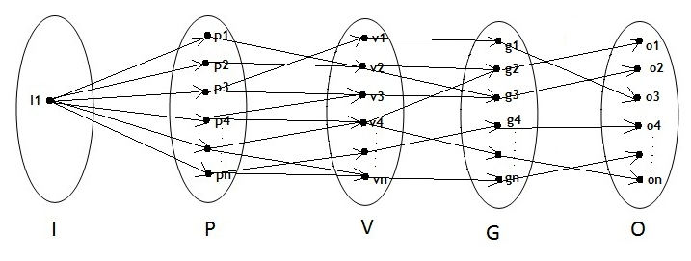
MATHEMATICAL MODEL
U= {I, P, V, G, O}
U = Set required for overall processes
I = Set of input objects
P = Set of trajectory points
V = Set of vectors
G = Set of gestures
O = Set of operations
PID: 14
20/24

Slide 21
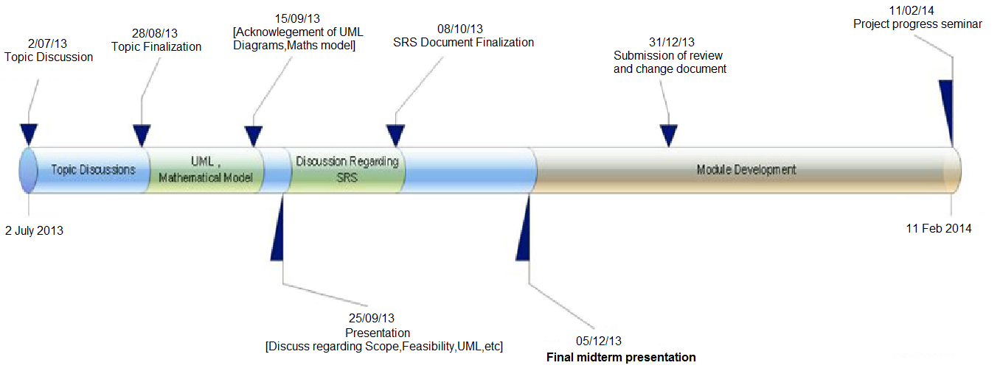
PROJECT TIMELINE
PID: 14
21/24

Slide 22
CONCLUSION
The proposed system overcomes the drawbacks of current systems
Can be used as an additional input method
PID: 14
22/24

Slide 23
REFERENCES
Object tracking using improved Camshift with SURF method Jianhong Li, Zhenhuan Zhou, Wei Guo, Bo Wang, Qingjie Zhao
Speeded Up Robust Features (SURF)
Herbert Bay, Andreas Ess, Tinne Tuytelaars, Luc Van Gool
en.wikipedia.com
Wikipedia, The online free encyclopedia
www.ieeexplore.ieee.com
Introduction to programming with OpenCV
Gady Agam
Notes on OpenSURF library
C. Evans
PID: 14
23/24

Slide 24
THANK YOU
PID: 14
24/24

